Slide 1



Manufacturing
Analytics
Project
Supervised By:-
Shakeeeb Qureshi
Saishwar Walke
P-1037

Slide 2








Our team at a glance
Srinivas Kurukunda
Rajat Mishra
Bhuwan Sharma
Varun raj
Hemalatha Boorsu
Vishwajit Balaji Tawade
Vijay Kumar

Slide 3
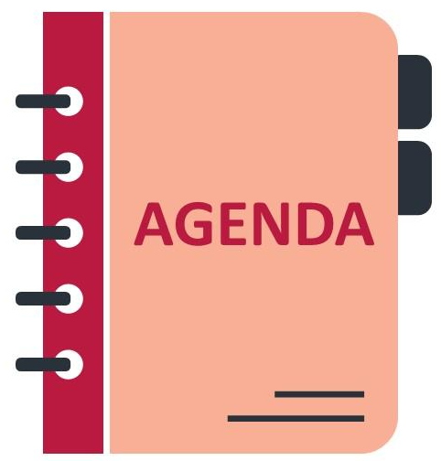
Agenda
Brief Introduction of Project
Project Goal
About the Dataset
Data Preparation & Cleaning
KPI Definition & Analytical Framework
Dashboards with Key Insights & Observations
Excel Dashboards
Power BI Dashboards
Tableau Dashboards
SQL Queries and Outputs
Project Outcomes
Project Conclusion
Project Closure

Slide 4

Project
Introduction
💡 Transforming Manufacturing Data into Intelligent Business Decisions
In today’s era of data-driven manufacturing, success depends not just on producing more, but on producing smarter, faster, and with higher precision. This project — “Manufacturing Analytics for Performance Optimization” — harnesses the power of operational data to analyze, visualize, and enhance production efficiency across the garment and textile manufacturing network.
Our dataset represents a real-world manufacturing ecosystem involving:
Multiple buyers (brands) placing orders,
Various manufacturing units (customers/vendors) executing them, and
Numerous employees and machines carrying out production tasks.
Each record in the dataset captures a snapshot of manufacturing activity — combining order details, operation parameters, manpower involvement, and quality outcomes. This integrated view enables us to assess not just how much is produced, but how efficiently and at what cost.

Slide 5

Project
Goal
🌟 Turning Manufacturing Data into Actionable Performance Insights
The primary goal of this project is to analyze, visualize, and optimize manufacturing performance across all operational levels — from buyers and customers to machines and employees — using a unified data-driven approach.
This project aims to convert raw factory data into a dynamic performance intelligence system that supports timely decision-making, cost optimization, and continuous process improvement in a garment and textile manufacturing environment
To establish a comprehensive analytics framework that can:-
Monitor Production Efficiency – Measure manufactured, processed, and rejected quantities across departments, designers, and buyers.
Identify Performance Gaps – Detect inefficiencies in employee productivity, machine utilization, and departmental throughput.
Reduce Waste & Rejections – Quantify and analyze rejection patterns to improve quality and minimize wastage.
Optimize Operational Cost – Correlate production volume with per-day machine cost and operational value to maximize profitability.
Enhance Decision Transparency – Provide management with KPI dashboards for real-time visibility and data-driven strategies.

Slide 6

Data
Description
🌟 Understanding the Foundation of Manufacturing Intelligence:-
The dataset used in this project represents the complete operational footprint of a garment and textile manufacturing ecosystem. It captures every key entity and interaction involved in the manufacturing lifecycle — from buyer order placement to final production output — enabling comprehensive analytics on efficiency, cost, and quality performance
Each record in the dataset corresponds to a unique production activity that links together:
Buyer (Brand) who places the order
Customer/Vendor (Factory Unit) executing it
Department / Designer handling the design and operation
Employee / Machine performing the task
Order & Work Order Details defining the timeline and quantities
This creates a multi-dimensional dataset that integrates operational, financial, and human performance data.

Slide 7
Main KPI
Analysis
The Key Performance Indicators (KPIs) form the foundation of the entire manufacturing performance evaluation system. Each KPI helps measure production efficiency, quality consistency, cost control, and workforce effectiveness — enabling leaders to identify strengths, weaknesses, and opportunities for optimization.
Category | KPI Name | Purpose / Focus Area
Production Performance | Manufactured Qty, Processed Qty, Produced Qty | Measures output capacity and operational throughput.
Quality Metrics | Rejected Qty, Wastage Qty, Rejection Ratio | Indicates quality consistency and defect control efficiency.
Employee Productivity | Employee-wise Rejection %, Emp-wise Output | Assesses individual performance, training needs, and skill impact.
Machine Efficiency | Machine-wise Rejection %, Per Day Machine Cost | Evaluates cost-effectiveness and utilization of machinery.
Operational Comparison | Manufactured vs. Rejected Trends | Tracks stability and improvement over time.
Departmental Effectiveness | Department-wise Manufacture vs. Rejected | Measures intra-department efficiency and accountability.
Financial KPI | Total Value, Cost per Operation | Links operational metrics with financial impact.

Slide 8

Dashboards
Excel Dashboards
Power BI Dashboards
Tableau Dashboards
SQL Queries and Results

Slide 9
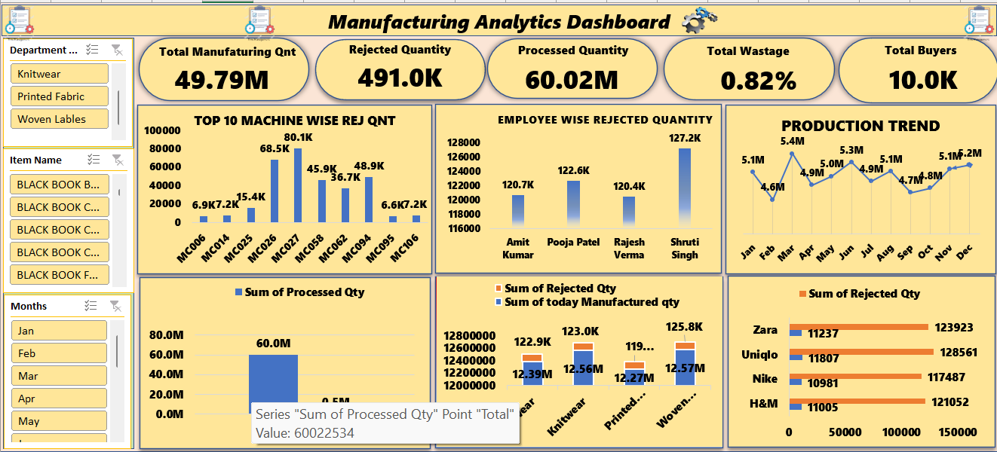
Excel Dashboard

Slide 10
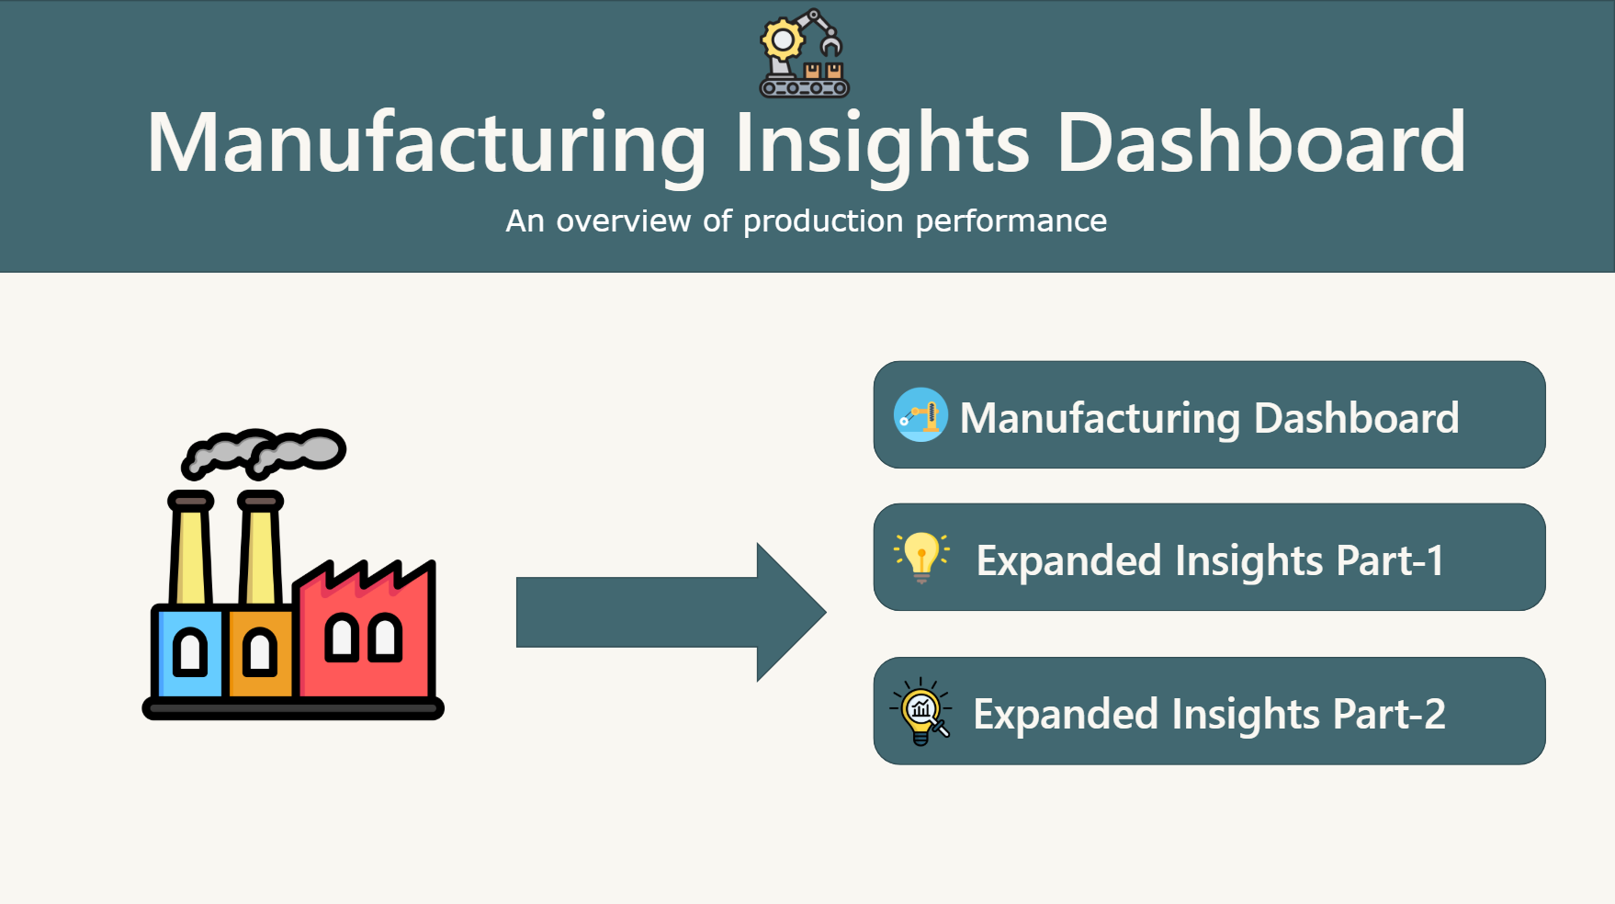
Power BI Dashboard

Slide 11
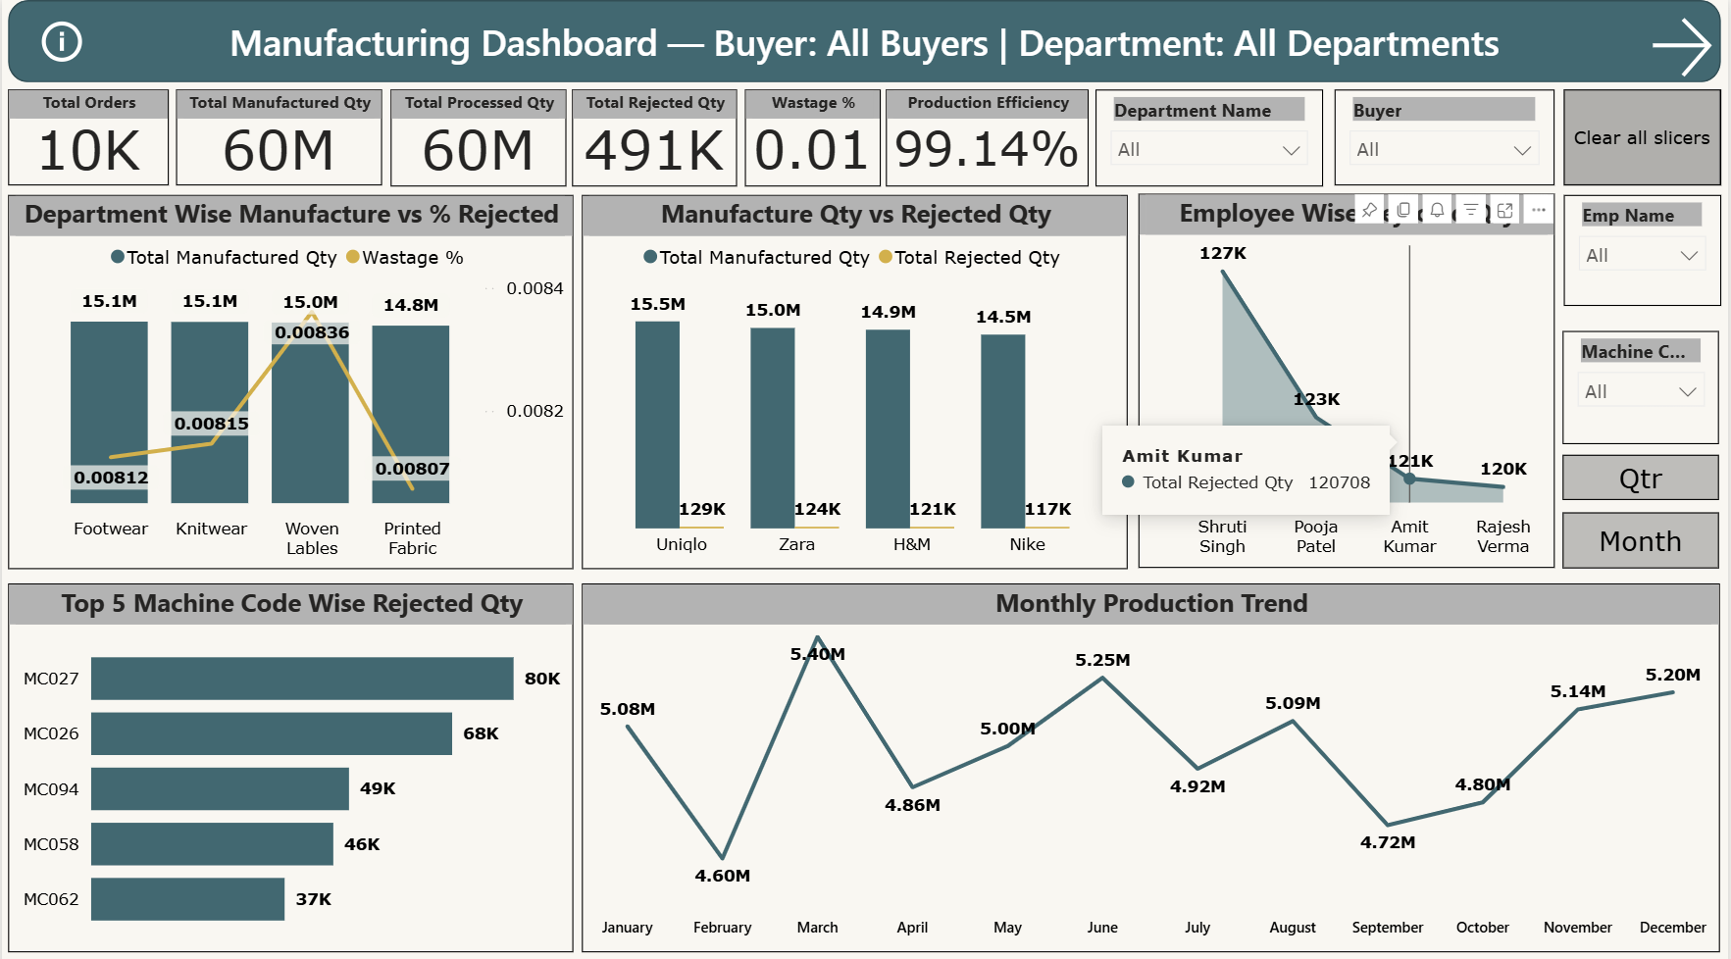
Power BI Dashboard

Slide 12
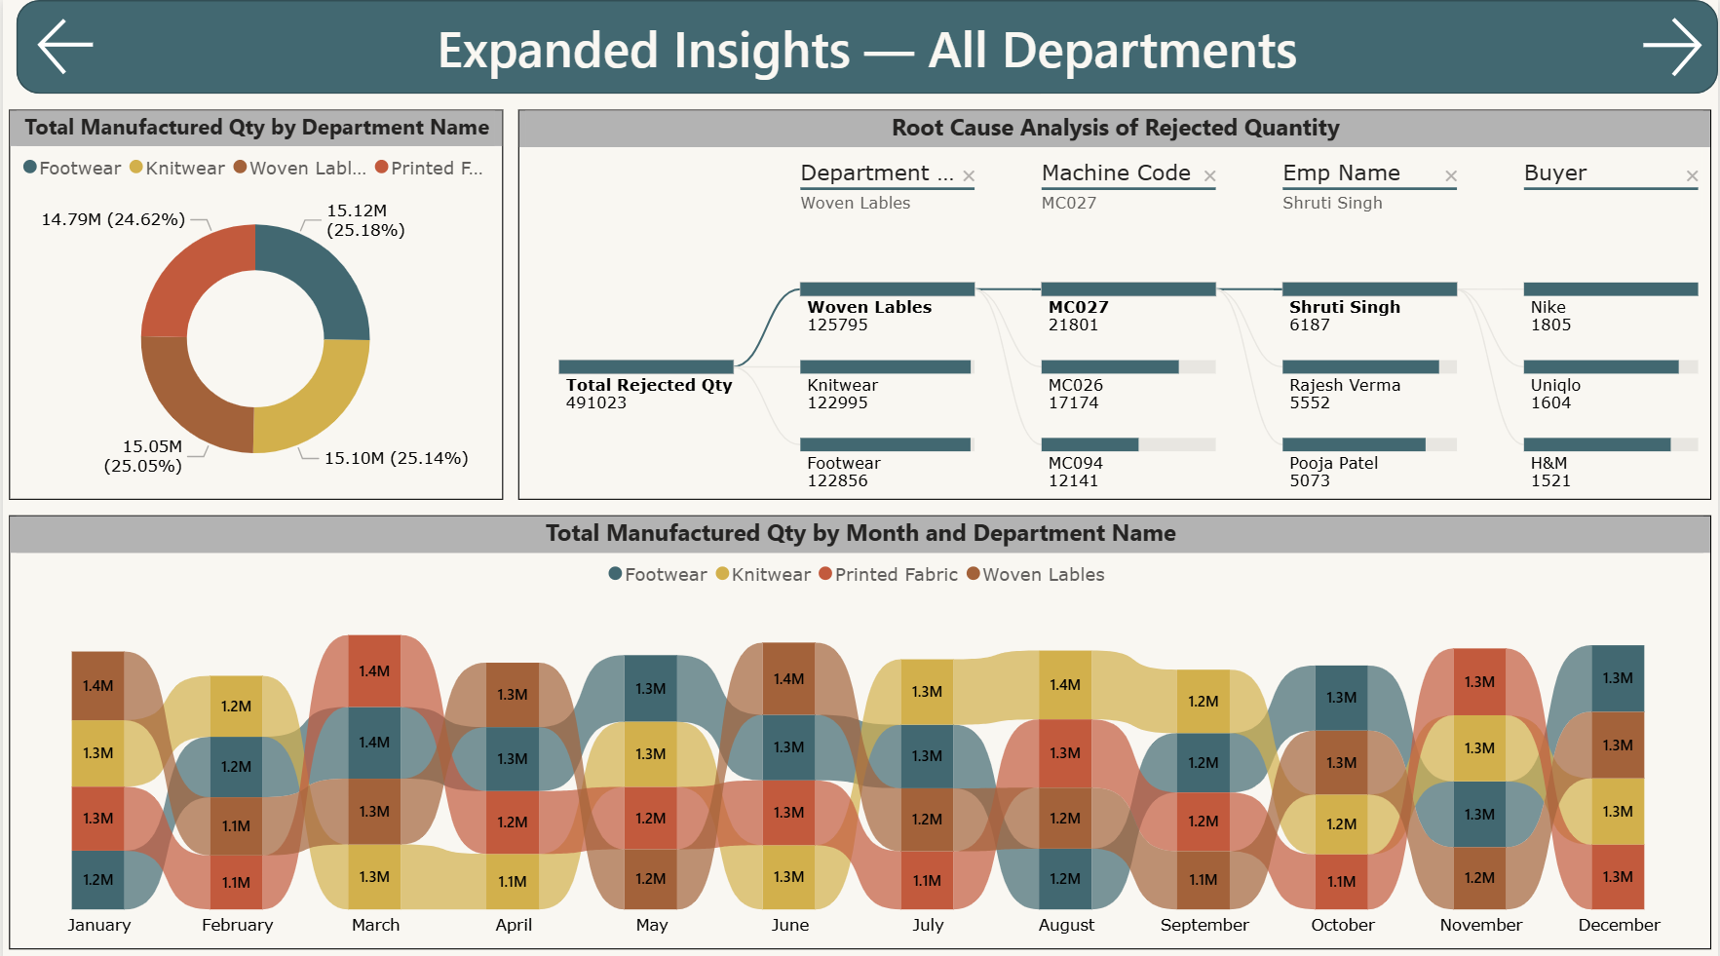
Power BI Dashboard

Slide 13
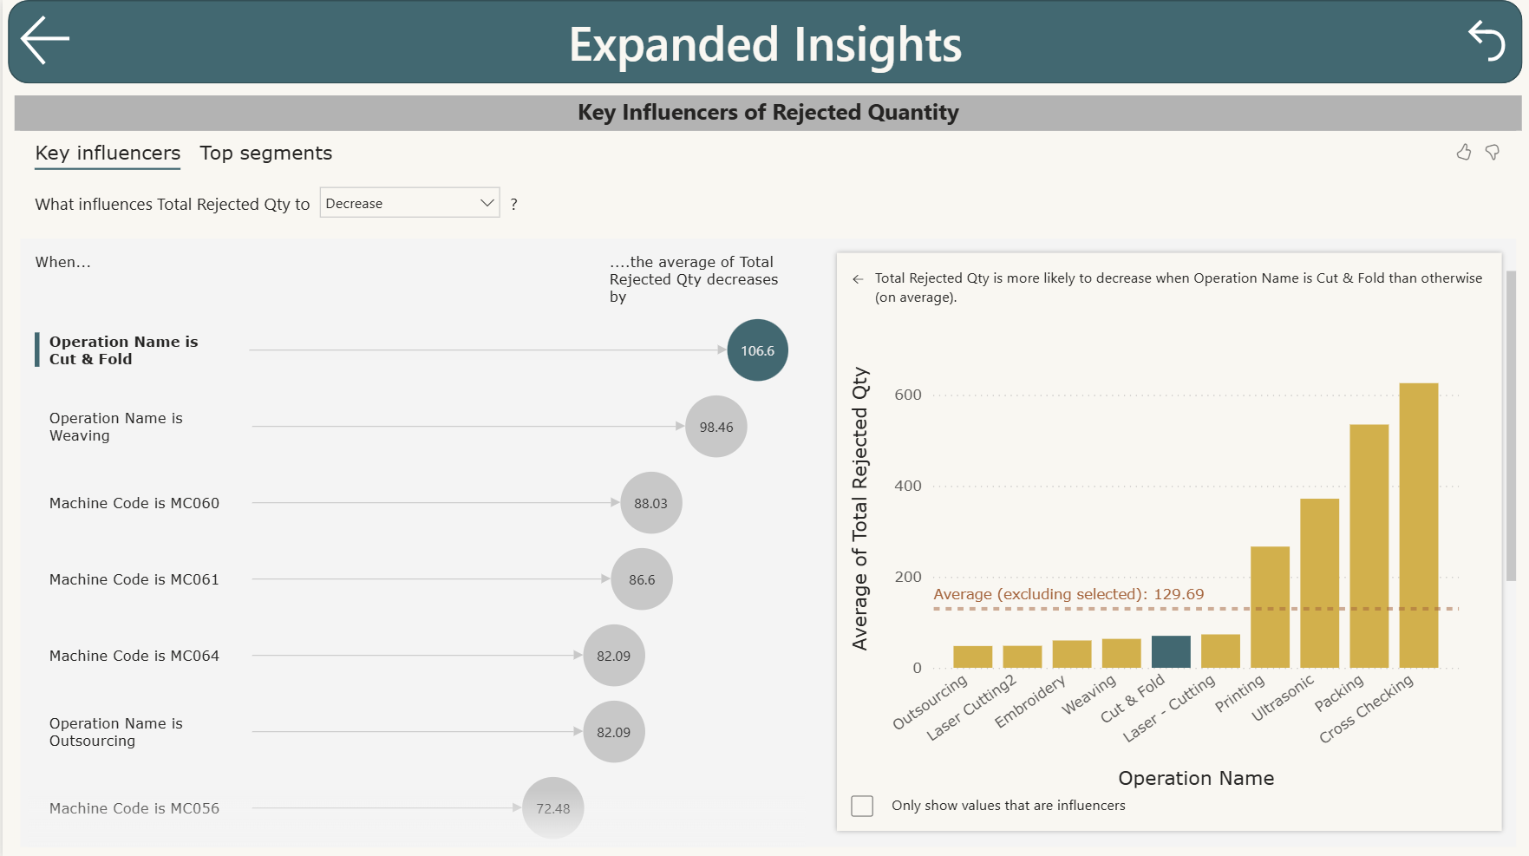
Power BI Dashboard

Slide 14
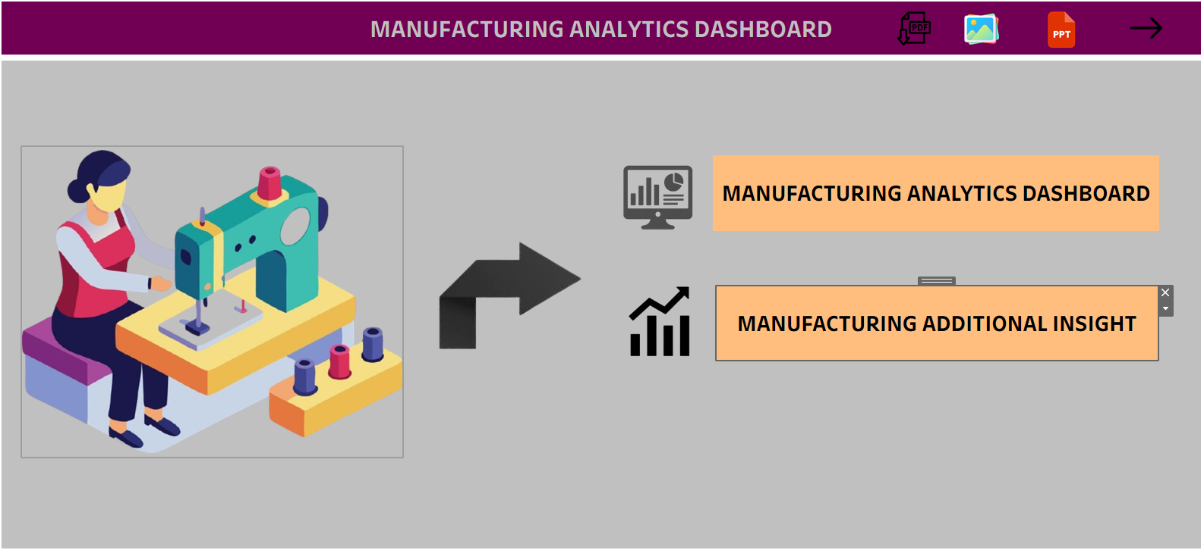
Tableau Dashboard

Slide 15
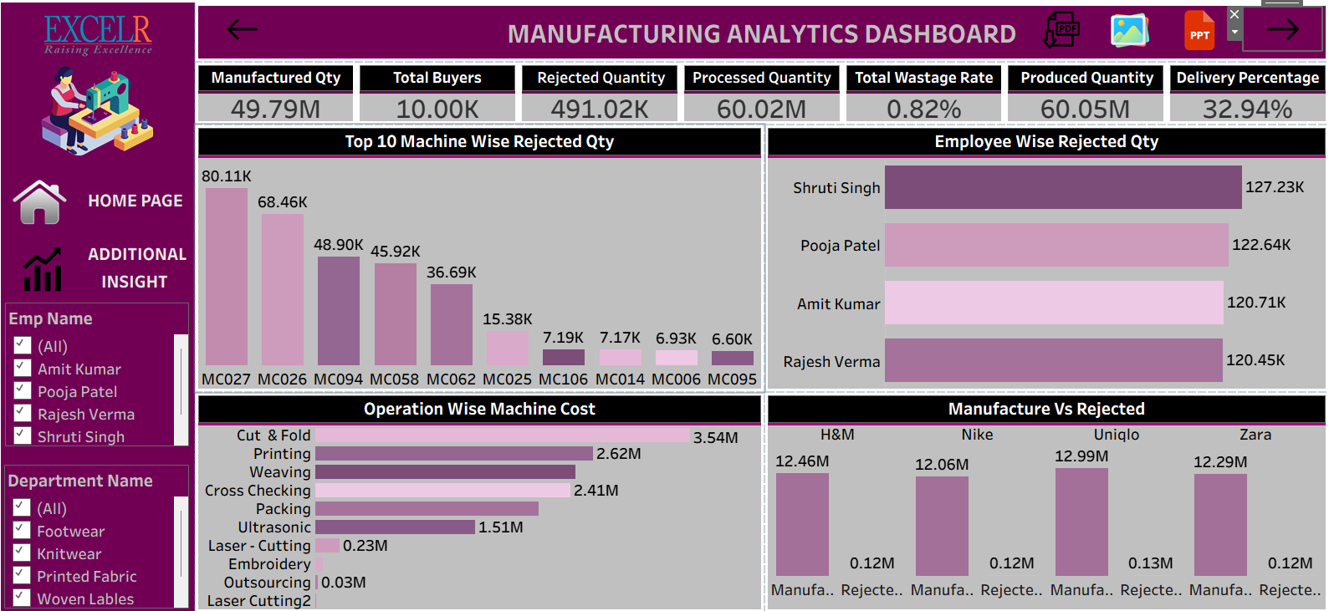
Tableau Dashboard

Slide 16
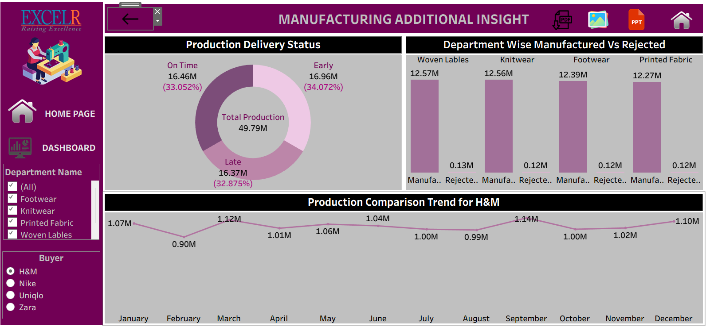
Tableau Dashboard

Slide 17
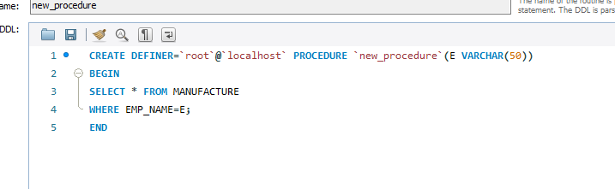
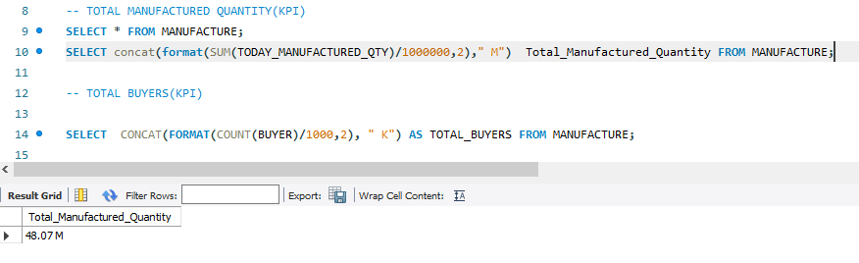
SQL Queries and Results

Slide 18
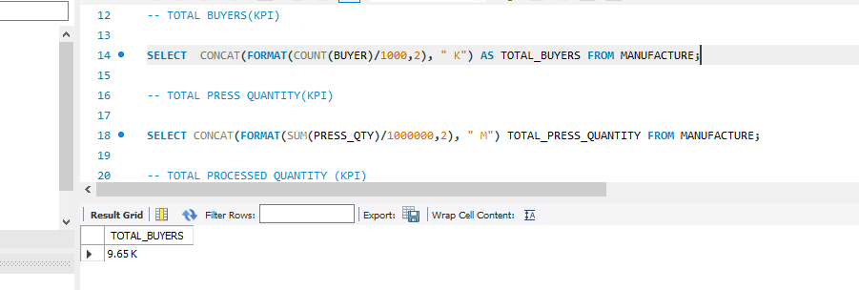
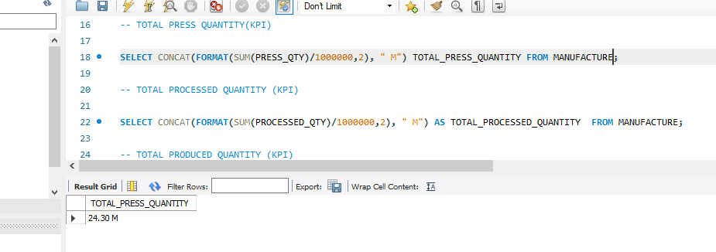
SQL Queries and Results

Slide 19
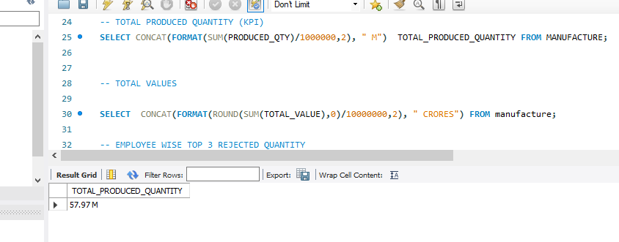
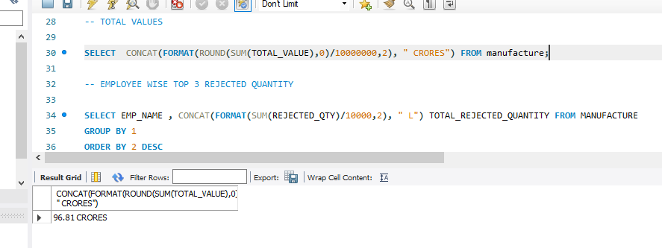
SQL Queries and Results

Slide 20
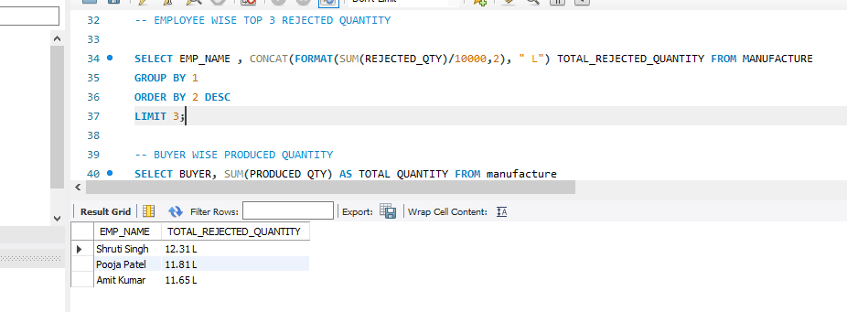
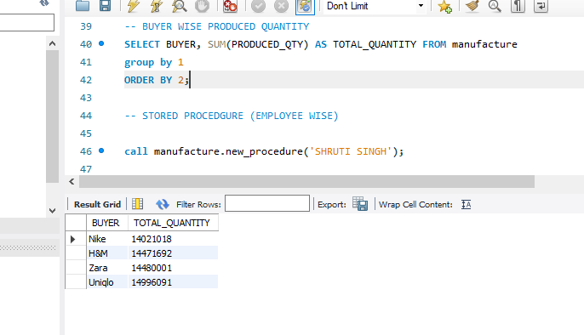
SQL Queries and Results

Slide 21
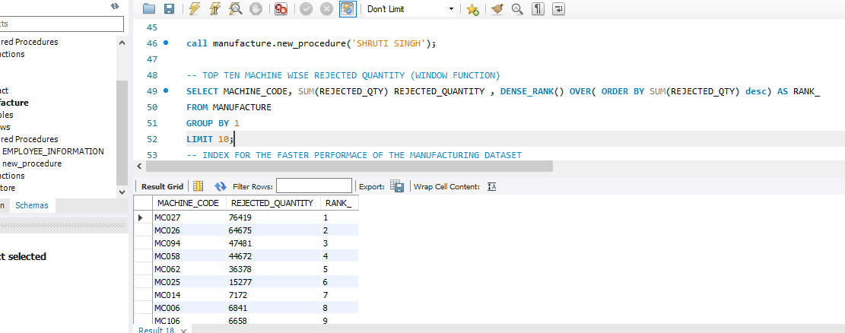
SQL Queries and Results

Slide 22

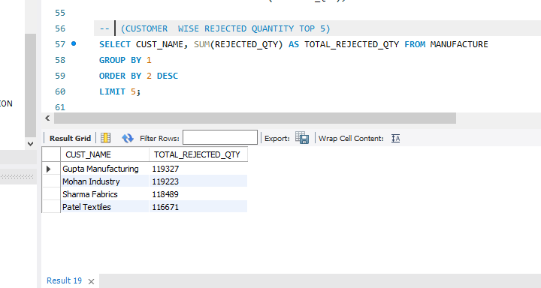
SQL Queries and Results

Slide 23
Project
Outcomes
🌟 From Data to Actionable Manufacturing Intelligence:-
The Manufacturing Analytics Project successfully transformed a large-scale production dataset into a performance intelligence system that delivers clear, measurable business outcomes.
🏭 A. Process Standardization
Established a consistent process for tracking, cleaning, and analyzing manufacturing data.
Created a reusable analytics framework for ongoing monitoring.
⚙️ B. Decision Enablement
Delivered interactive dashboards providing daily visibility of production efficiency and rejections.
Enabled data-driven decision-making rather than intuition-based management.
👥 C. Workforce Empowerment
Recognized top-performing employees and departments.
Used analytics to identify targeted skill gaps, improving morale and accountability.
💵 D. Financial Optimization
Linked operational KPIs (machine cost, rejection rate) directly to profitability metrics.
Supported management in strategic cost control and buyer profitability evaluation.
🧩 E. Digital Transformation Foundation
Transformed traditional manual reports into an automated, analytics-based environment.
Set the groundwork for future AI-driven forecasting (e.g., demand prediction, rejection prediction).

Slide 24
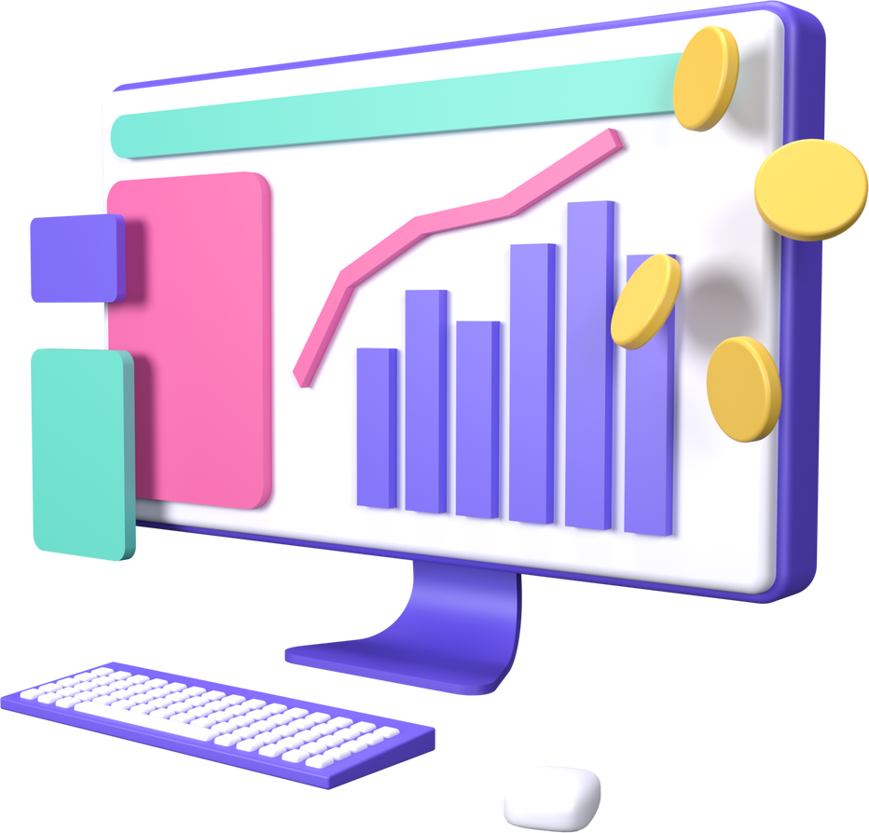
Project
Conclusion
🔹 Operational Excellence
Real-time tracking of manufacturing performance across all buyers and departments.
Recognition of bottlenecks and inefficiencies through rejection ratio analysis.
Clear visibility into machine-level cost impact and productivity.
🔹 Workforce Empowerment
Quantified employee performance through objective data metrics.
Established transparent performance measurement and recognition system.
Enabled leadership to make training and manpower allocation decisions backed by analytics.
🔹 Financial Intelligence
Connected operational KPIs to financial outcomes such as cost per unit and total order value.
Supported management in assessing buyer profitability and investment returns.
🔹 Decision Transformation
Replaced static, manual decision-making with dynamic data dashboards.
Created a culture of accountability through metric-based insights.

Slide 25

Thank
You!
The project’s focus on real-time data insights, predictive analytics, and modular flexibility ensures that manufacturers of multiple clothing brand can benefit from the solution, ultimately leading to more streamlined operations, improved decision-making, and a better ability to compete in a rapidly evolving marketplace.

